Slide 1

Data Base Management System
BY: DR. NAINA PAL

Slide 2

Brief Introduction about Subject
A database management system (DBMS) refers to the technology for creating and managing databases. DBMS is a software tool to organize (create, retrieve, update, and manage) data in a database.
The main aim of a DBMS is to supply a way to store up and retrieve database information that is both convenient and efficient. By data, we mean known facts that can be recorded and that have embedded meaning. Usually, people use software such as DBASE IV or V, Microsoft ACCESS, or EXCEL to store data in the form of a database. A datum is a unit of data. Meaningful data combined to form information. Hence, information is interpreted data - data provided with semantics. MS. ACCESS is one of the most common examples of database management software.
Video link: https://www.youtube.com/watch?v=kBdlM6hNDAE&list=PLxCzCOWd7aiFAN6I8CuViBuCdJgiOkT2Y

Slide 3
2.4 Relational Calculus
In contrast to Relational Algebra, Relational Calculus is a non-procedural query language, that is, it tells what to do but never explains how to do it.
Relational calculus exists in two forms −
Tuple Relational Calculus (TRC)
Filtering variable ranges over tuples
Notation : {T | Condition}
Returns all tuples T that satisfies a condition.
For example −
{ T.name | Author(T) AND T.article = 'database' }
Output − Returns tuples with 'name' from Author who has written article on 'database'.

Slide 4
2.4.1 Tuple Relational Calculus (TRC)
TRC can be quantified. We can use Existential (∃) and Universal Quantifiers (∀).
For example −
{ R| ∃T ∈ Authors(T.article='database' AND R.name=T.name)}
Output − The above query will yield the same result as the previous one.

Slide 5
2.4.2 Domain Relational Calculus (DRC)
Domain Relational Calculus (DRC)
In DRC, the filtering variable uses the domain of attributes instead of entire tuple values (as done in TRC, mentioned above).
Notation : { a1, a2, a3, ..., an | P (a1, a2, a3, ... ,an)}
Where a1, a2 are attributes and P stands for formulae built by inner attributes.

Slide 6
Domain Relational Calculus (DRC)
For example −{< article, page, subject > | ∈ TutorialsPoint ∧ subject = 'database'}
Output − Yields Article, Page, and Subject from the relation TutorialsPoint, where subject is database.
Just like TRC, DRC can also be written using existential and universal quantifiers. DRC also involves relational operators.
The expression power of Tuple Relation Calculus and Domain Relation Calculus is equivalent to Relational Algebra.

Slide 7

Syllabus of Unit 3
Database Design & Normalization:
Functional dependencies, normal forms, first, second, third normal forms, BCNF, inclusion dependence, loss less join decompositions, normalization using FD, MVD, and JDs, alternative approaches to database design.
Book References:
1. Korth, Silbertz, Sudarshan,” Database Concepts”, McGraw Hill
2. Date C J, “An Introduction to Database Systems”, Addision Wesley
3. Elmasri, Navathe, “ Fundamentals of Database Systems”, Addision Wesley
4.Bipin C. Desai, “ An Introduction to Database Systems”, Galgotia Publications

Slide 8
Topic 1 objective
Informal Design Guidelines for Relational Databases
1.1Semantics of the Relation Attributes
1.2 Redundant Information in Tuples and Update Anomalies
1.3 Null Values in Tuples
1.4 Spurious Tuples
Summary of Informal database Design

Slide 9
1.1Semantics of the Relation Attributes
Whenever we group attributes to form a relation schema, we assume that attributes belonging to one relation have certain real-world meaning and a proper interpretation associated with them.
The semantics of a relation refers to its meaning resulting from the interpretation of attribute values in a tuple.
GUIDELINE 1: Informally, each tuple in a relation should represent one entity or relationship instance.
Attributes of different entities should not be mixed in the same relation
Only foreign keys should be used to refer to other entities.
Entity and relationship attributes should be kept apart as much as possible.
Design a schema that can be explained easily relation by relation. The semantics of attributes should be easy to interpret.

Slide 10
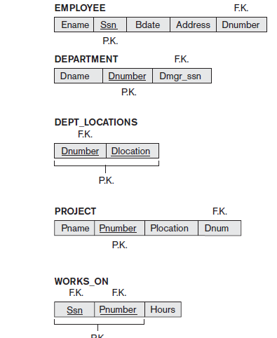
A simplified COMPANY relational database schema

Slide 11
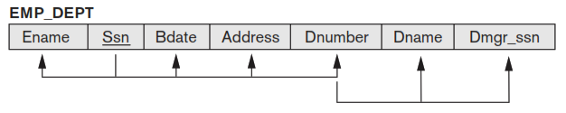
Examples of Violating Guideline 1
Attributes of different entities should not be mixed in the same relation
Informally, each tuple in a relation should represent one entity or relationship instance.
Design a schema that can be explained easily relation by relation. The semantics of attributes should be easy to interpret.

Slide 12
1.2 Redundant Information in Tuples and Update Anomalies
1.2. A :- Redundant Information in Tuples
One goal of schema design is to minimize the storage space used by the base relations (and hence the corresponding files). Grouping attributes into relation schemas has a significant effect on storage space.

Slide 13
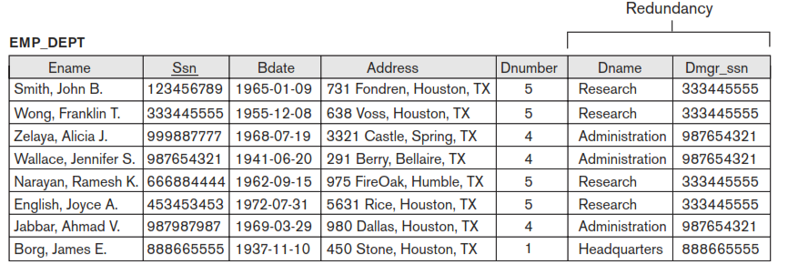
Redundant Information in Tuples
Mixing attributes of multiple entities may cause problems.
1. Information is stored redundantly wasting storage, compare the space used by the two base relations EMPLOYEE and DEPARTMENT in with that for an EMP_DEPT base relation . (Wastage of Space by Emp_Dept)

Slide 14
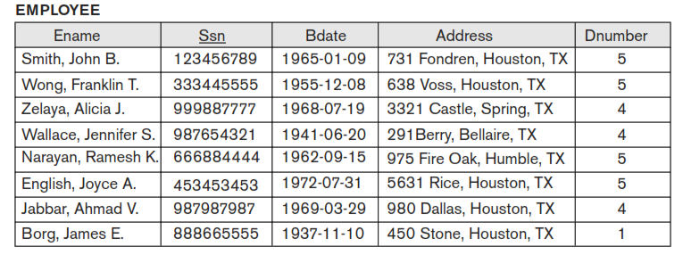
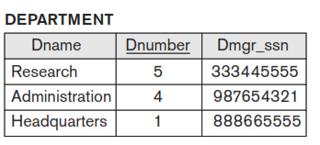
1.2 A. Redundant Information in Tuples
Example :- Good database Design Approach

Slide 15

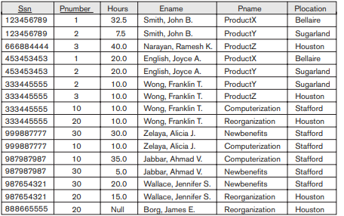
1.2.B. Problems with update anomalies
Update Anomaly:- An update anomaly is a data inconsistency that results from data redundancy and a partial update.
Consider the relation:
Update Anomaly: Changing the name of project number 1 from “ProductX” to “ProductABC” may cause this update to be made for all n employees working on project 1.

Slide 16
1.2. B. Problems with update anomalies
Problems with update anomalies
Insertion anomalies
Deletion anomalies
Modification anomalies

Slide 17
Insertion anomalies
1. To insert a new employee tuple into EMP_DEPT, we must include either the attribute values for the department that the employee works for, or NULLs (if the employee does not work for a department as yet).
Example
2. But, It is difficult to insert a new department that has no employees as yet in the EMP_DEPT relation. The only way to do this is to place NULL values in the attributes for employee. This violates the entity integrity for EMP_DEPT because its primary key Ssn cannot be null.

Slide 18
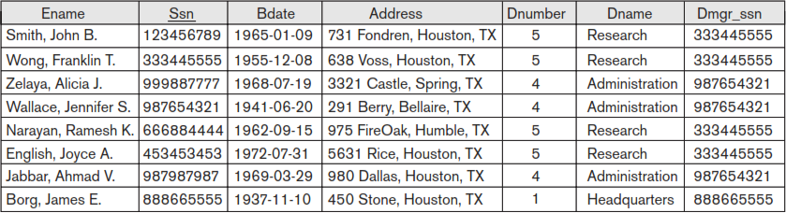
Deletion Anomalies
The problem of deletion anomalies is related to the second insertion anomaly situation just discussed. If we delete from table EMP_DEPT an employee tuple that happens to represent the last employee working for a particular department, the information concerning that department is lost accidentally from the database.
Example :- Emp_Dept
When a department is deleted, it will result in deleting all the employees who work only on that project. Alternately, if an employee is the sole employee on a department, deleting that employee would result in deleting the corresponding project.

Slide 19
Modification anomalies
In EMP_DEPT, if we change the value of one of the attributes of a particular department—say, the manager of department 5—we must update the tuples of all employees who work in that department;
otherwise, the database will become inconsistent. If we fail to update some tuples, the same department will be shown to have two different values for manager in different employee tuples, which would be wrong.
Example :- Emp_Dept

Slide 20
1.3 Null Values in Tuples
In some schema designs we may group many attributes together into a “fat” relation. If many of the attributes do not apply to all tuples in the relation, we end up with many NULLs in those tuples.
Example
This can waste space at the storage level and may also lead to problems with understanding the meaning of the attributes and with specifying JOIN operations at the logical level.
Another problem with NULLs is how to account for them when aggregate operations such as COUNT or SUM are applied
Note :- If NULL values are present, the results may become unpredictable.

Slide 21
Guideline Null Values in Tuples
GUIDELINE 3: As far as possible, avoid placing attributes in a base relation whose values may frequently be NULL. If NULLs are unavoidable, make sure that they apply in exceptional cases only and do not apply to a majority of tuples in the relation.
Relations should be designed such that their tuples will have as few NULL values as possible (wastage of space in storage level and difficulties in JOIN operation with NULL values).
Attributes that are NULL frequently could be placed in separate relations (with the primary key).

Slide 22
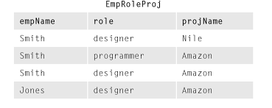
1.4 Generation of Spurious Tuples
A spurious tuple is, basically, a record in a database that gets created when two tables are joined badly (before or after decomposition). In databases, spurious tuples are created when two tables are joined on attributes that are neither primary keys nor foreign keys.
Example :-

Slide 23
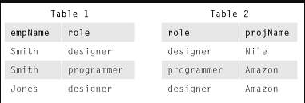
1.4 Generation of Spurious Tuples
The two relations Table1 and Table2 as the base relations of EMPRoleProj, is not a good schema design.
Problem is if a Natural Join is performed on the above two relations it produces more tuples than original set of tuples in EMPRoleProj.
These additional tuples that were not in EMPRoleProj are called spurious tuples because they represent spurious or wrong information that is not valid.
This is because the role attribute which is used for joining is neither a primary key, nor a foreign key in either Table1 and Table2.

Slide 24
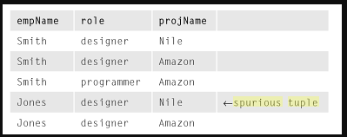
Example with spurious tuple
Result of applying NATURAL JOIN to the tuples in Table1 and Table2,just for EMPRoleProj with {Jones, Designer ,Nile } generated spurious tuples.

Slide 25
1.4 Generation of Spurious Tuples
Guideline 4
Design relation schemas so that they can be joined with equality conditions on attributes that are appropriately related (primary key, foreign key) pairs in a way that guarantees that no spurious tuples are generated.
Avoid relations that contain matching attributes that are not (foreign key, primary key) combinations because joining on such attributes may produce spurious tuples.
Note :- This informal guideline obviously needs to be stated more formally. we discuss a formal condition called the non-additive (or lossless) join property that guarantees that certain joins do not produce spurious tuples.

Slide 26
Summary of Informal database Design
The problems we pointed out, which can be detected without additional tools of analysis, are as follows:-
Anomalies that cause redundant work to be done during insertion into and modification of a relation, and that may cause accidental loss of information during a deletion from a relation.
Waste of storage space due to NULLs and the difficulty of performing selections, aggregation operations, and joins due to NULL values.
Generation of invalid and spurious data during joins on base relations with matched attributes that may not represent a proper (foreign key, primary key) relationship

Slide 27
Summary of Informal database Design
we present informal concepts and theory that may be used to define the goodness and badness of individual relation schemas more precisely.
Now we discuss functional dependency as a tool for analysis.

